Slide 1

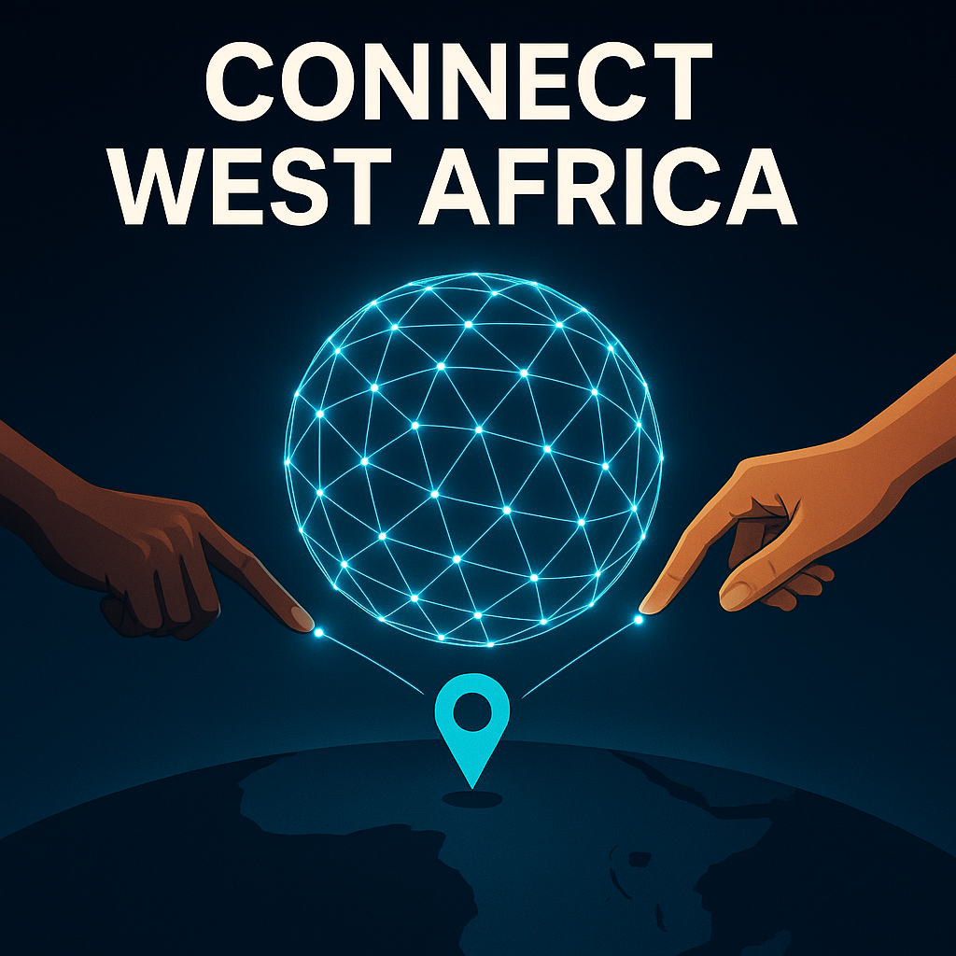
Gbe Mesh & Guaso Coin
Cheap Internet for Millions of West Africans

Slide 2
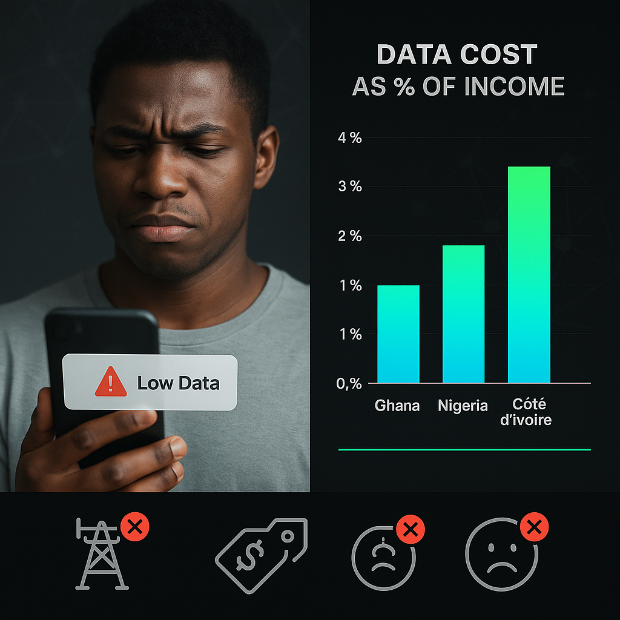
Problem
High mobile-data costs in West Africa (0.6–2% of income)

Slide 3
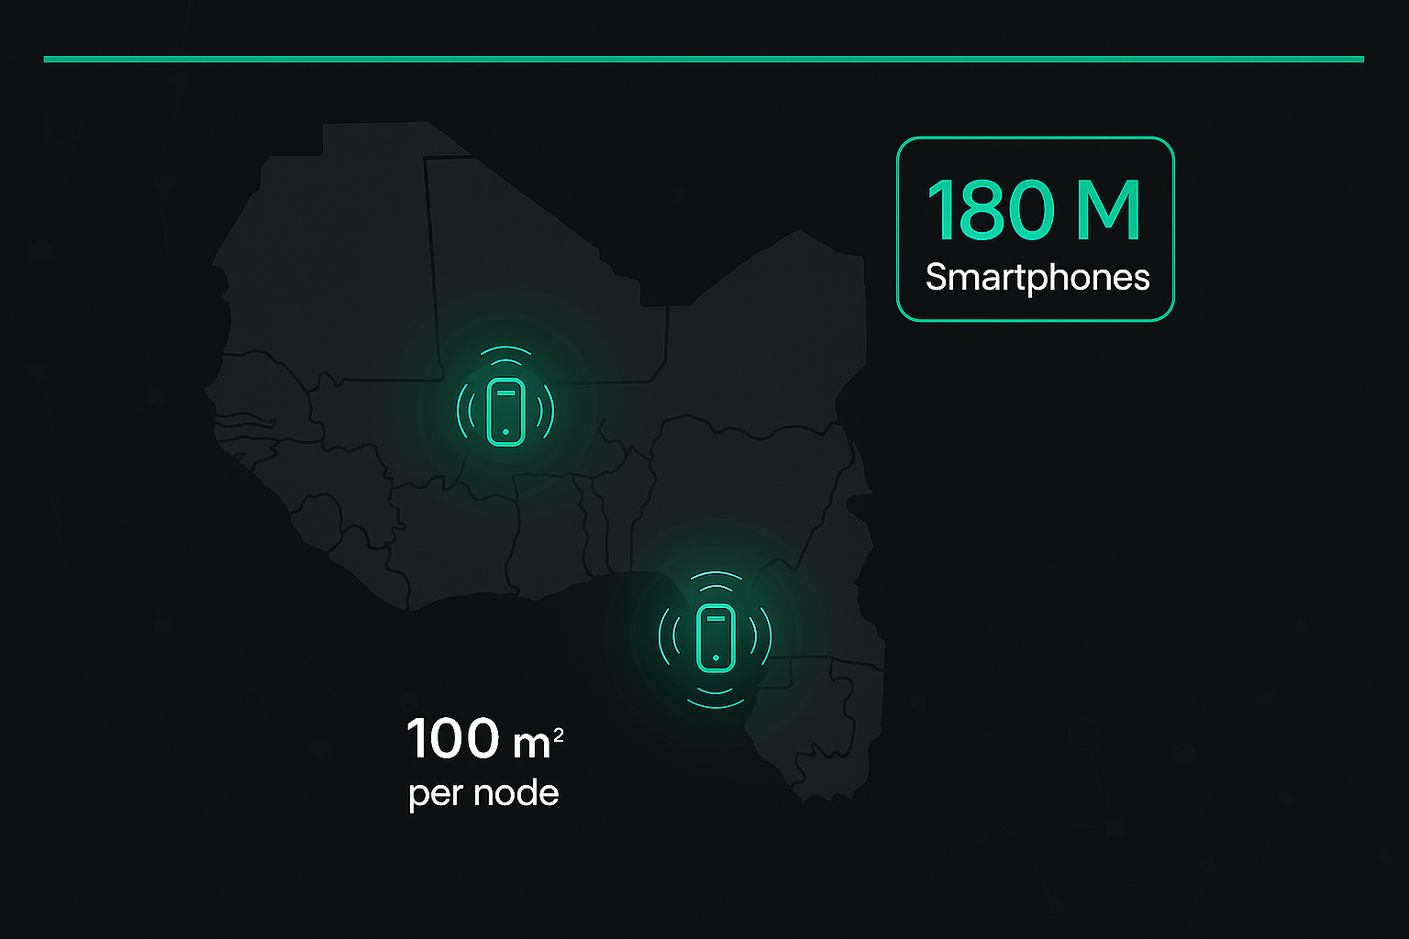
Solution:
Decentralized Mesh-Network
Phone → ‘mesh-node’
using Wi-Fi Direct + BLE to communicate
95% Cheaper!

Slide 4
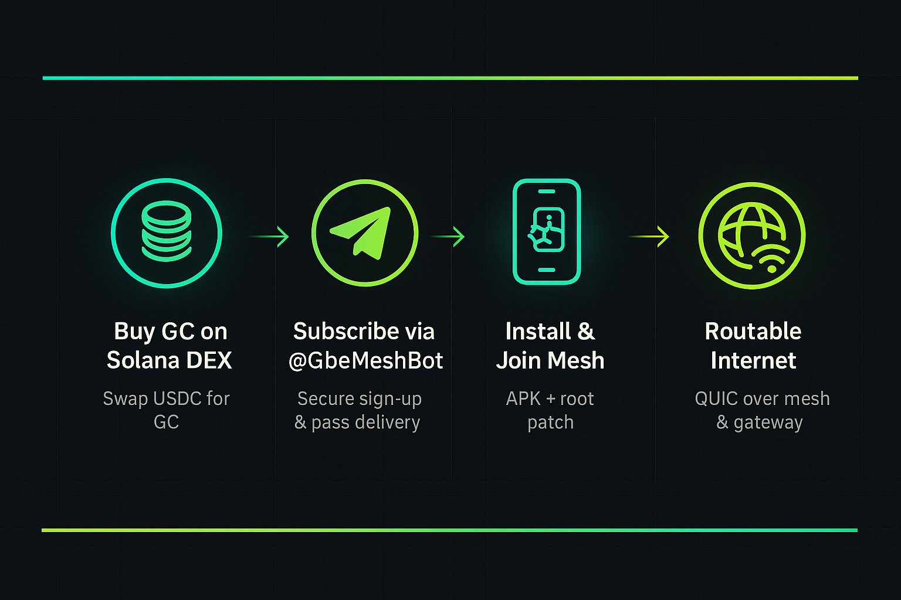
How it works

Slide 5
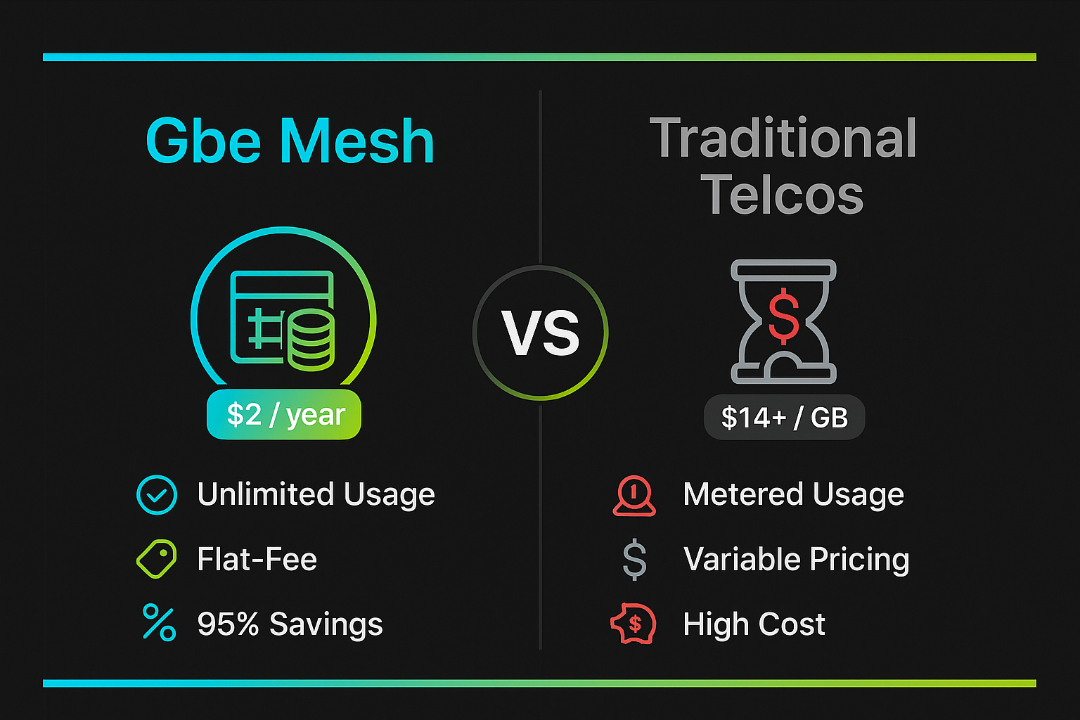

Slide 6
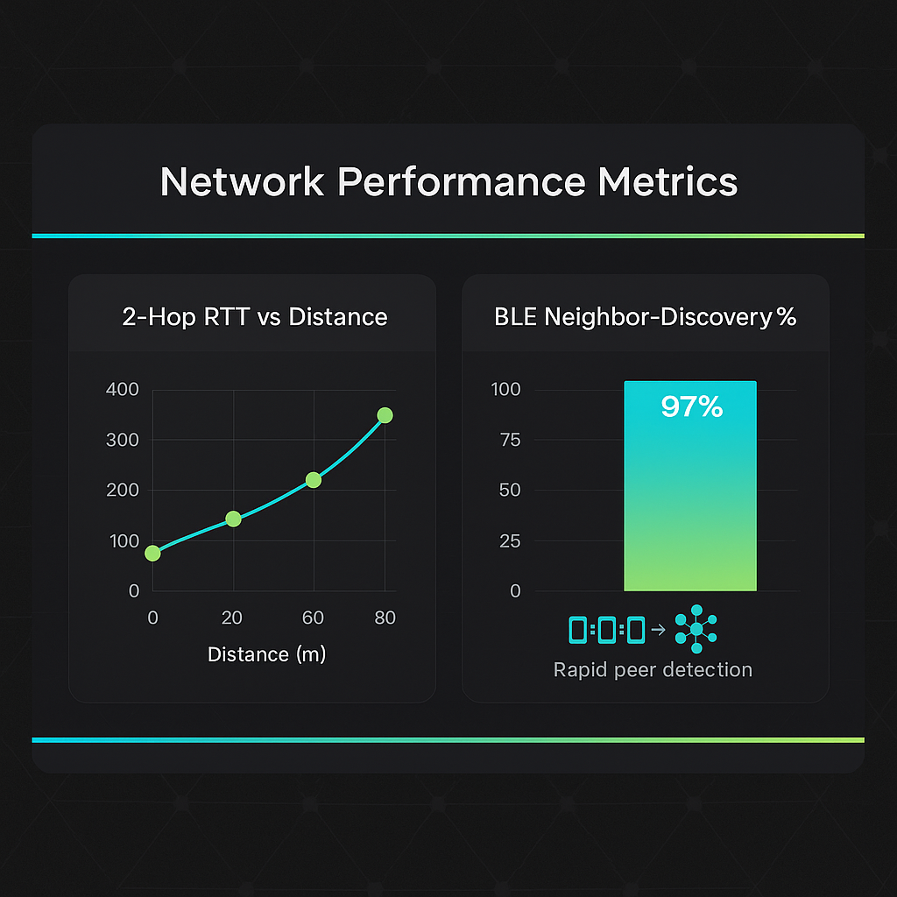

Slide 7
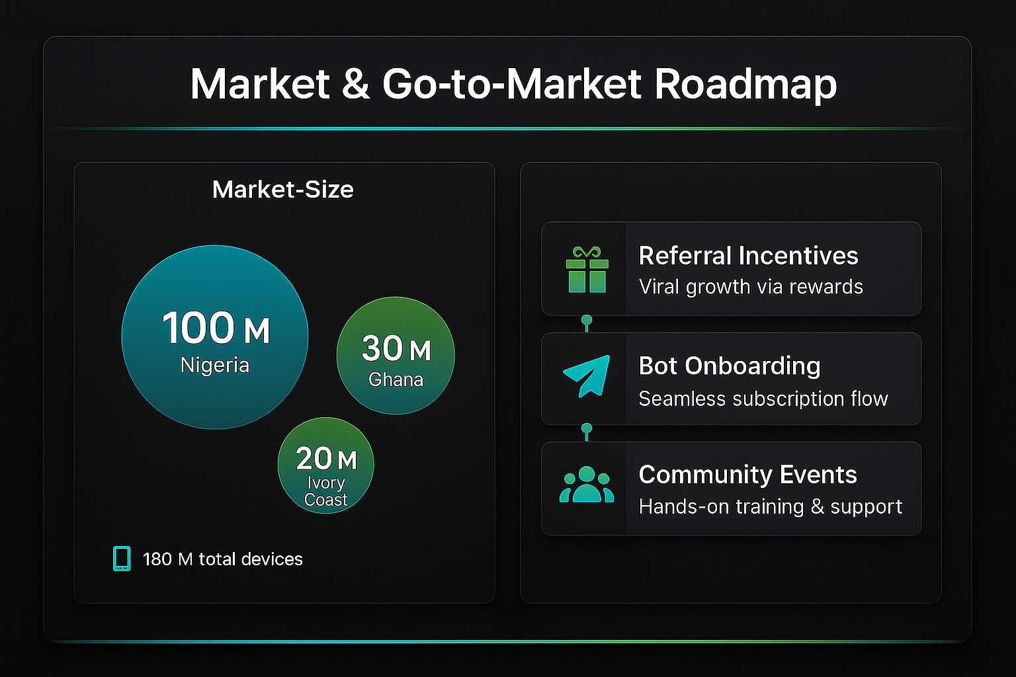

Slide 8
Join the mesh on Telegram:
@GbeMeshBot

